Slide 1
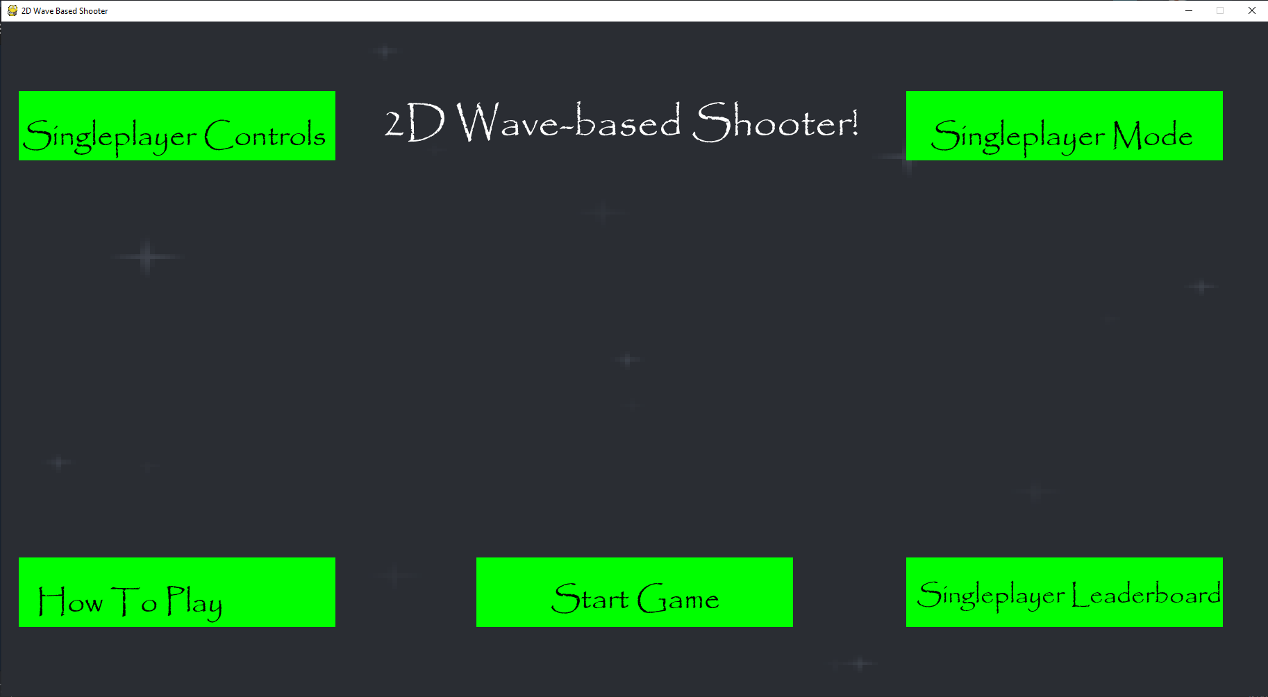
On the main menu, all of the boxes that can be clicked on are easily identifiable because they are all in green and are all in the same font.
All the buttons are also very large and therefore quite noticeable and are all labelled clearly with what section they will lead to.

Slide 2
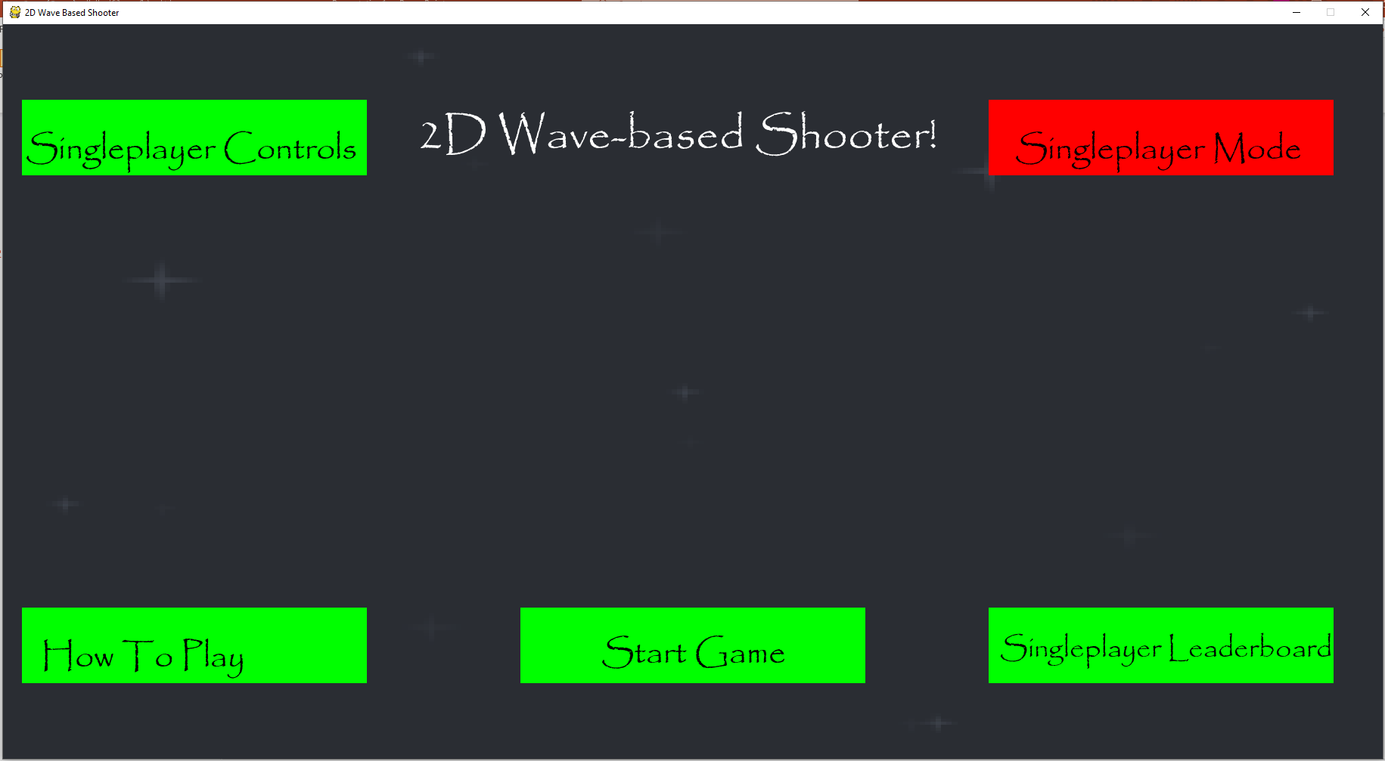
When the cursor hovers over a box, it will turn red to show that it can be clicked on. So it is very clear when a box can and can’t be clicked on.

Slide 3

When the singleplayer box is clicked, the game will go into multiplayer mode, which is shown by the text in the box changing.
When the game switches to multiplayer mode, the text in the leaderboard and controls boxes changes to include multiplayer. This means that player knows that the contents of these sections change when they enter multiplayer mode.

Slide 4
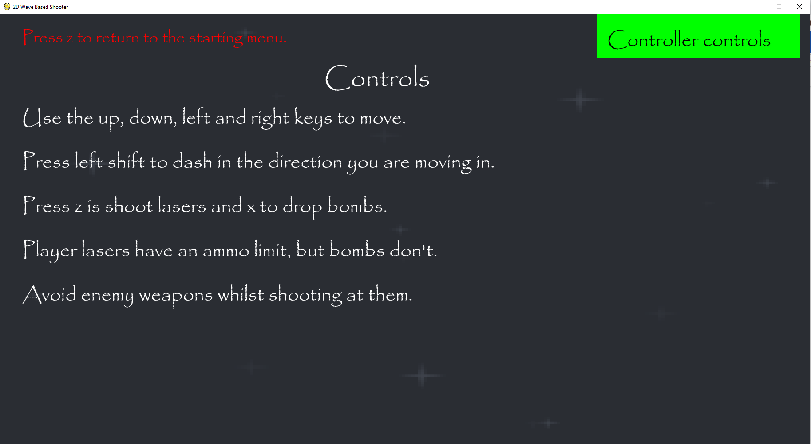
The green box in the top right-hand corner highlights another section that can be clicked on, which takes you to the controller controls.
All of the section that you can go to have text in red in the top left-hand corner which allows you to return to the main menu.
When you click on the controls sections, the controls themselves are clearly displayed to you with text of the same colour and font, so it is easy for someone to understand how to play the game.

Slide 5
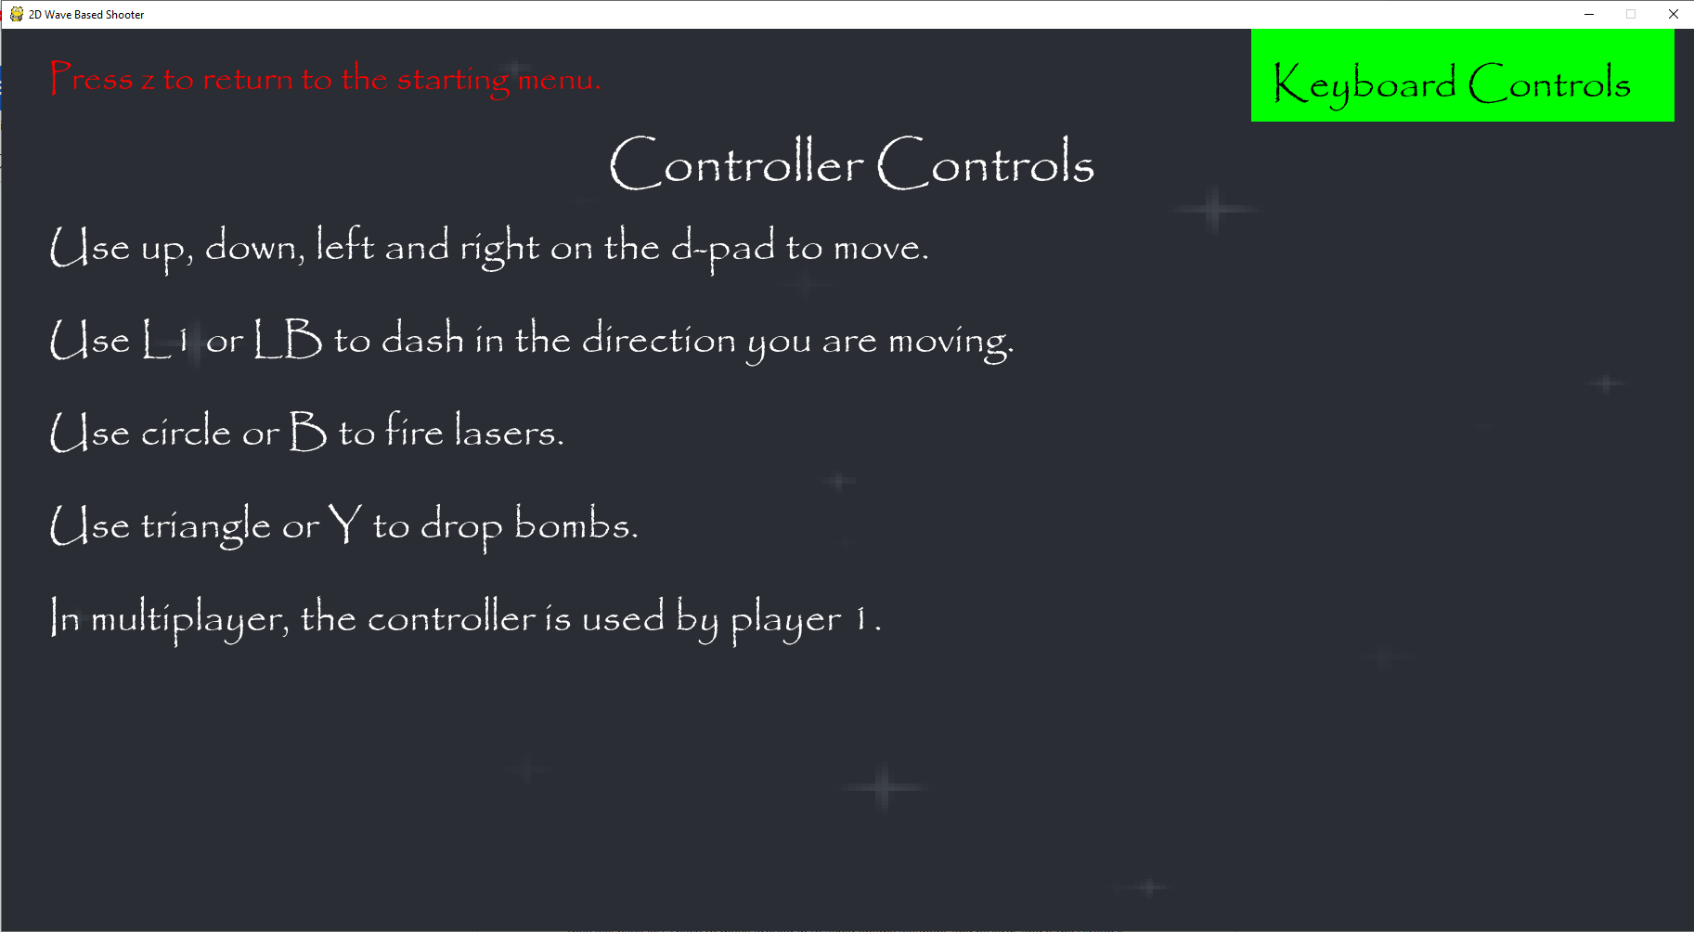
The green box here lets you return to the keyboard controls when you click on it. Both it and the controller controls box turn red when the cursor hovers over them.
This is the section you are taken to when you click controller controls.
The controls here are also presented line-by-line in the same font and colour so that it is easy to understand how to play the game with a controller.

Slide 6
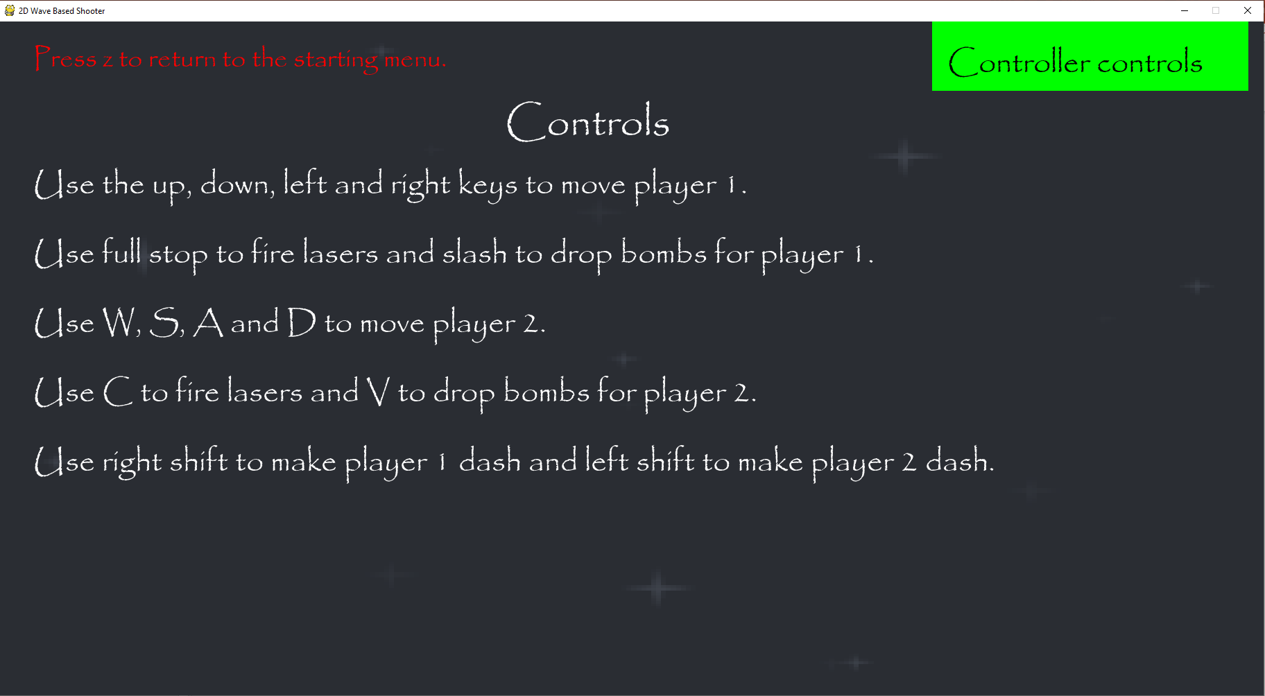
The green box here lets you go to the controller controls, which stay the same in multiplayer mode, when you click on it.
When you click the multiplayer Controls section, this is what you are taken to.
The controls here are presented using different lines to show the movement and shooting of player 1 and the movement and shooting of player 2. This means that the controls for both players clear and understandable.

Slide 7
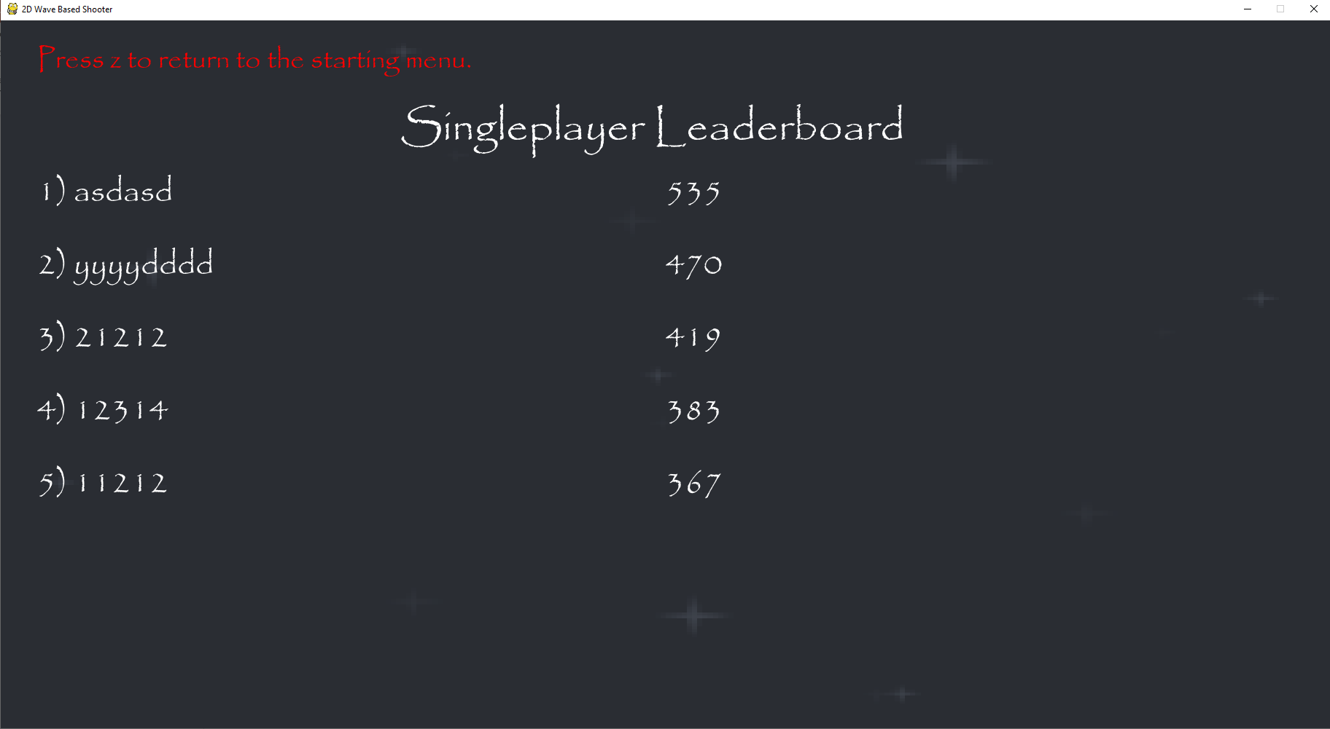
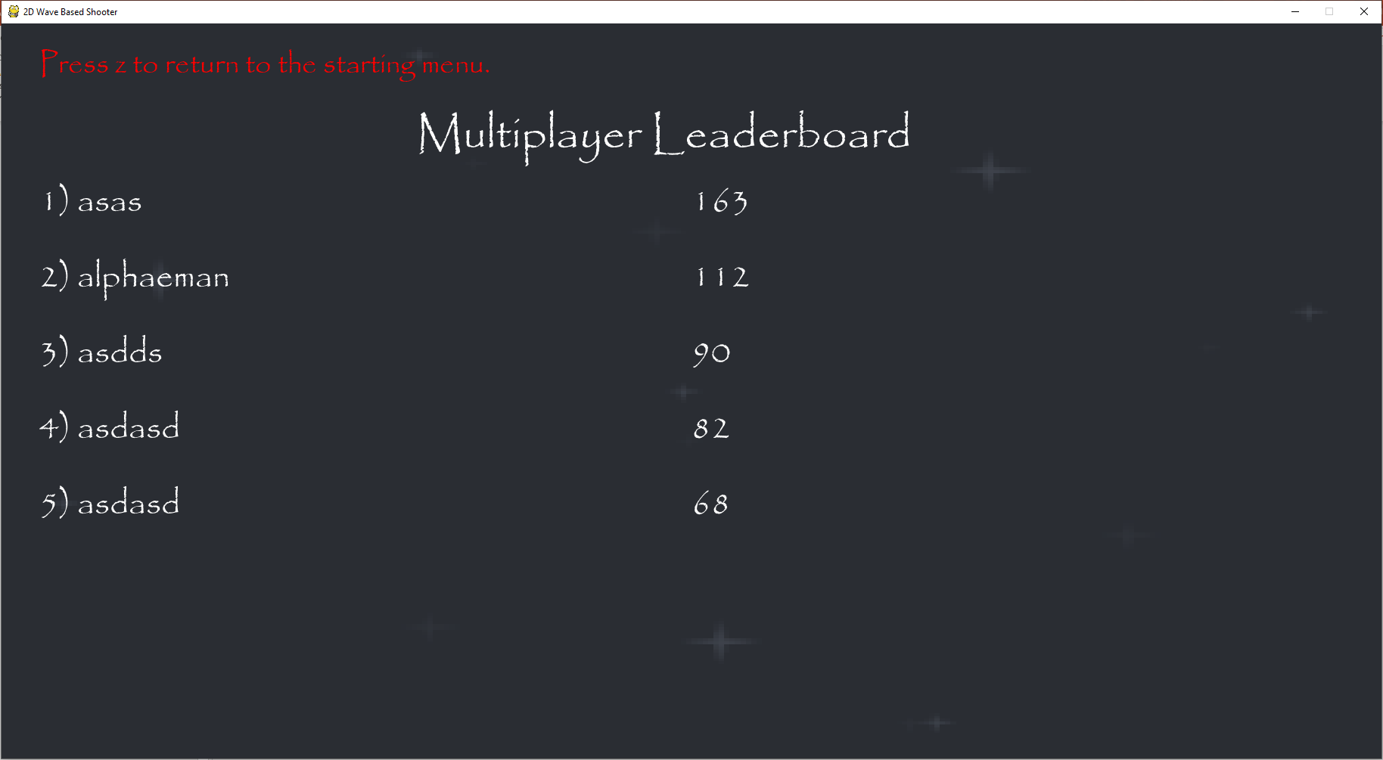
Both leaderboards are labelled so the user knows if they are looking at singleplayer or multiplayer scores.
Both the singleplayer and multiplayer leaderboards shows the top five scores along with the player names in a consistent manner with scores being ranked in descending order. This makes it easy to understand who was first and how many points they got and who was second and so on.

Slide 8
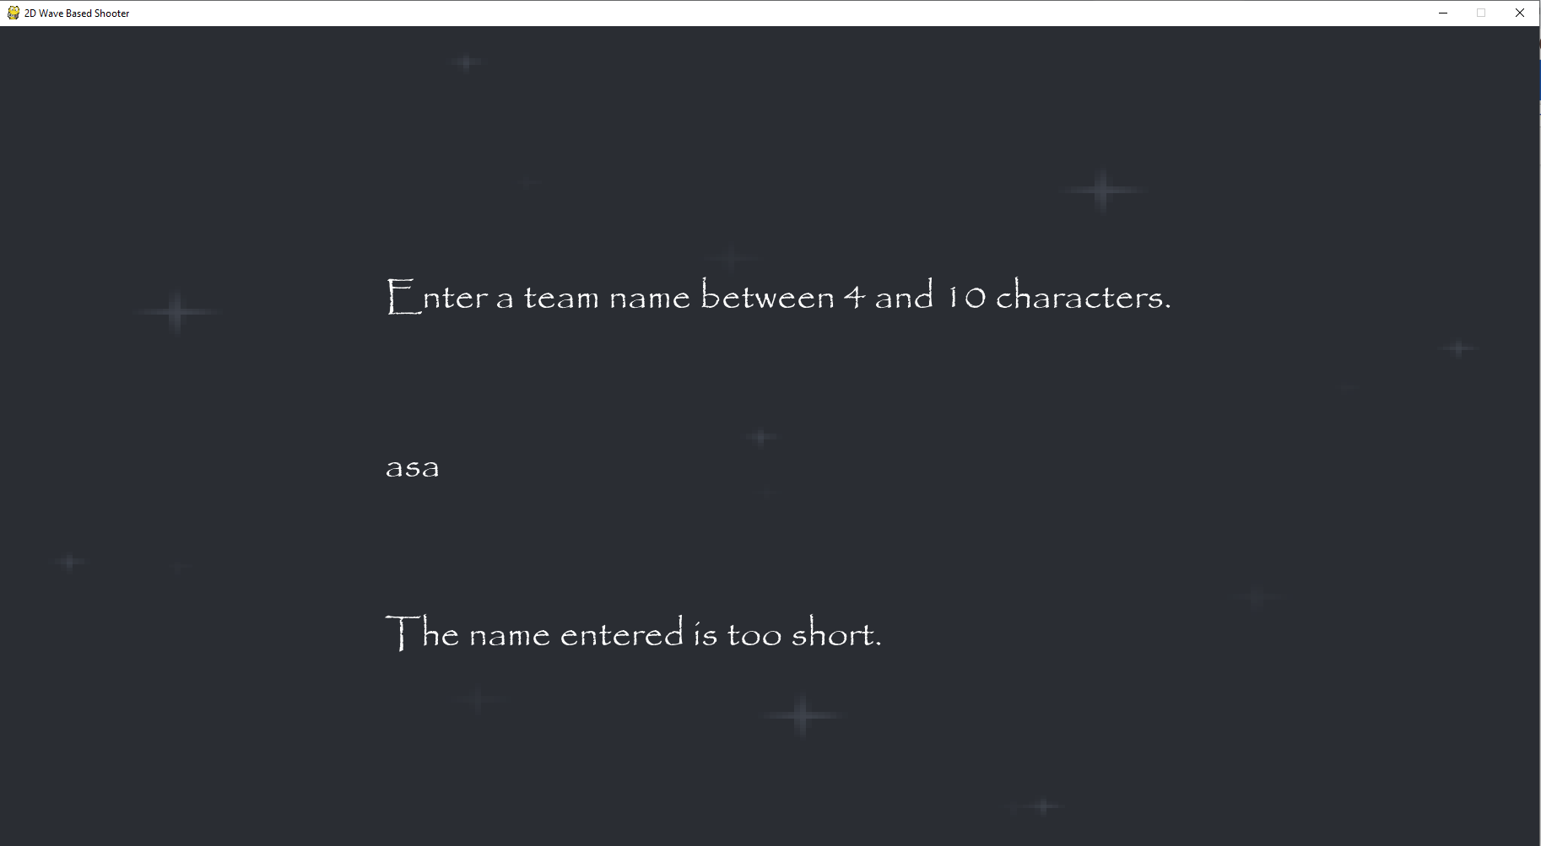
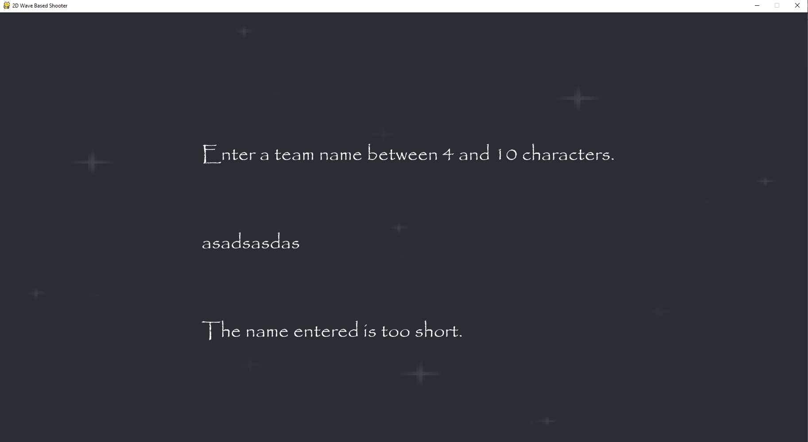
When entering a player or team name before a game, if it is less than 4 characters then the game will tell the player that it is too short, so they will immediately know to enter a longer name.
You are unable to enter a player or team name that is more than 10 characters as the game prevents anymore characters from being entered. This means that the player can’t exceed the character limit on their name.

Slide 9
When entering a player or team name before a game, if it is less than 4 characters then the game will tell the player that it is too short, so they will immediately know to enter a longer name.
You are unable to enter a player or team name that is more than 10 characters as the game prevents anymore characters from being entered. This means that the player can’t exceed the character limit on their name.

